Slide 1













Stickerly
Prepared by:
Omar Magdi
Nourelden Mohamed
malak Elshazly
Menna Walid
Salma Maher

Slide 2

about us
We are a local brand offering high-quality stickers with diverse, customizable designs to suit every style. Our products combine creativity, variety, and affordability for personal and business use.
https://www.instagram.com/stickerly101?
https://www.facebook.com/share/15kx93hDju/

Slide 3
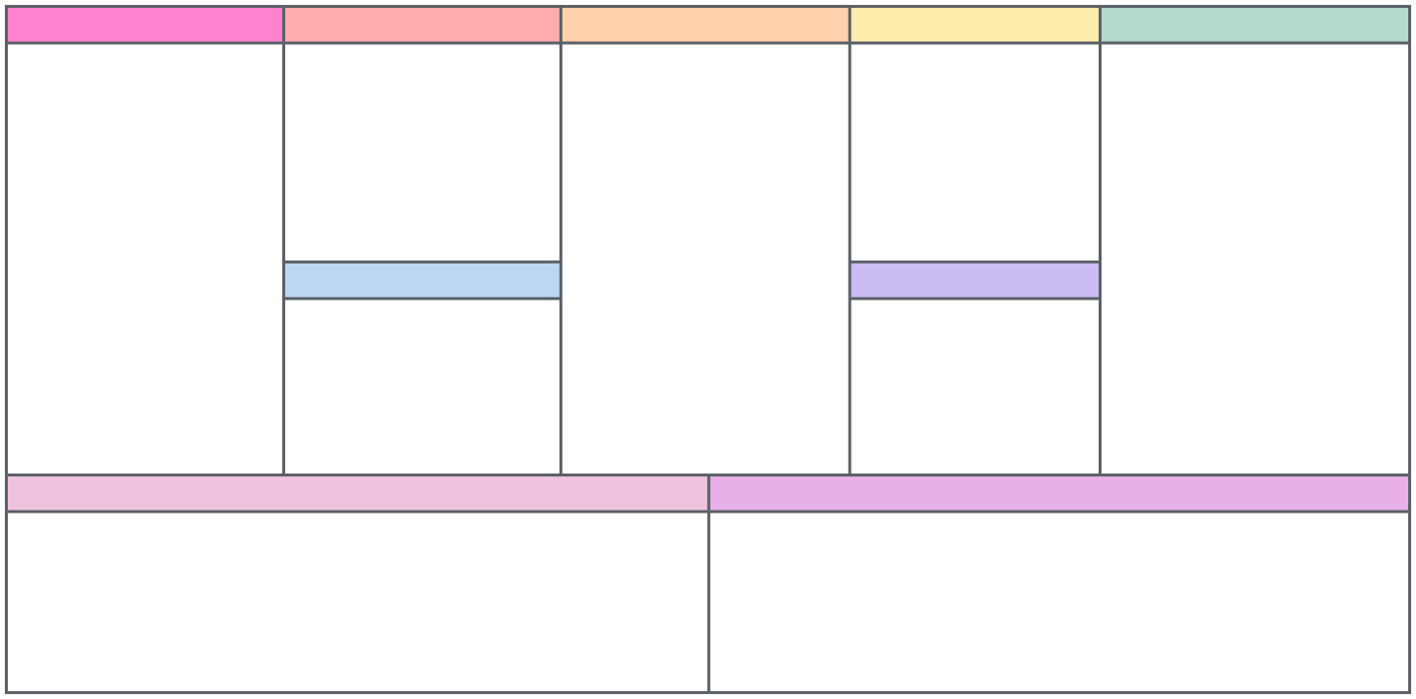
BUSINESS MODEL CANVAS
Key Partners
Key Activities
Value Propositions
Customer RelationsHip
Customer Segments
Designing and preparing stickers for printing. Marketing through social media platforms. Managing orders and shipping logistics. Engaging with customers and analyzing their interests.
Continuous engagement through social media. Regular offers and discounts for loyal customers. Fast customer support and quick responses to inquiries. Custom orders for exclusive designs.
Customized sticker High-quality, water-resistant, and scratch-resistant prints Stickers available in various sizes and shapes.
Student aged 17 to 24 from egypt especially mansoura Design and art enthusiasts. Students who use stickers to decorate their personal items.
High-quality sticker printing press Suppliers of printing materials. Shipping and delivery companies. Influencers on social media platforms. Local stores to retail the products. Paid platform for creating stickers (such as Canva Pro, Adobe Photoshop, or Illustrator
Key Resources
Competitive prices with special discounts for bulk orders. Customized stickers for your interests and hobbies with competitive prices and high quality
Channels
Anime, gaming, and music fans looking for unique stickers.
High-quality sticker printing machine Software for sticker design, such as Photoshop or Illustrator Marketing team Tools for packaging stickers Agreement with a reliable shipping company
Facebook and Instagram pages Direct sales at events and local fairs.
Cost Structure
Revenue Stream
Competators
Selling stickers individually or in bundles.
Dakkn
Sticky up
Sticka
Jazzico
Pledge
A3dt_underground
Stickers print
Sticker zone
Subscription to a design platform (Canva Pro, Adobe Illustrator, etc.) Packaging materials (bags, labels, small boxes, etc.). Domain and website hosting (optional). Agreement with a shipping company. Paid ads (Facebook, Instagram, etc. Printing costs at the printing press
Custom design services for customers.

Slide 4
STRENGTHS
WEAKNESS
Creative and different designs
Targeting wider audiance Easy of use and distribution
Good and fast engagement
Customization
Affordable pricing with high value
Difficult to standing in a market full of competitors
Lack of experience
Limited budget
Low brand awareness
SWOT
OPPORTUNITIES
THREATS
Most competitors focus on static posts, not Reels chance to stand out with video content.
Inconsistent posting by competitors allows our to maintain a stronger presence.
Many don’t use Stories, so we can increase engagement through daily updates.
Competitors are active on either Facebook or Instagram, not both opportunity to cover more platforms
Competitors offer fast shipping.
Some have higher product quality.
Wide variety of sizes and shapes available elsewhere.
Strong customization options .
Frequent promotions and discount offers , Participation in events and exhibitions.
Professional websites that enhance trust and accessibility

Slide 5
Objectives
Awareness
Engagement
Sales
Post 40 posts and +60 stories.
Gain 400-800 followers.
Achieve 20% interaction on posts and stories.
Achieve 50-100 direct messages.
Achieve 20-30 orders.
Contribution between us and small libraries, workspaces, or mobile and laptop repair shops.

Slide 6
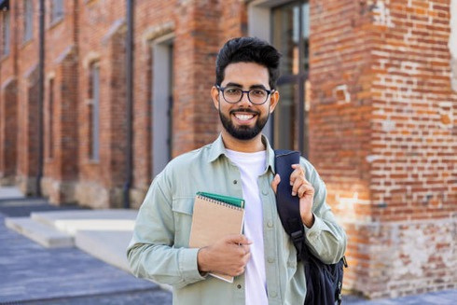

Buyer persona
Name: Hana
Age: 20
City: Mansoura
Hobbies: Swimming-books-Drawing
College: Faculty of physical therapy
Name: Anas
Age: 24
City: Mansoura
Hobbies: Programming-digital marketing-Anime-Ropotics
College: Faculty of Computer and Information science
provide the customer with customized Stickers upon request
USP

Slide 7
Product
Unique stickers for university students + customized stickers.
Promotion
Facebook ads + posting sticker photos on Facebook & Instagram + Reels showcasing designs to boost engagement.
4Ps/7Ps Marketing mix
Price
Sheet = 50 EGP — Market-competitive prices + flexible for custom orders and bulk.
Process
Order via DM → Preparation in 1-3 days Shipping in 2-5 days.
People
Small team - friendly and fast customer interaction.
Place
Selling via Instagram & Facebook + shipping across Egypt.
Physical Evidence
Product photos + well-organized social media pages

Slide 8
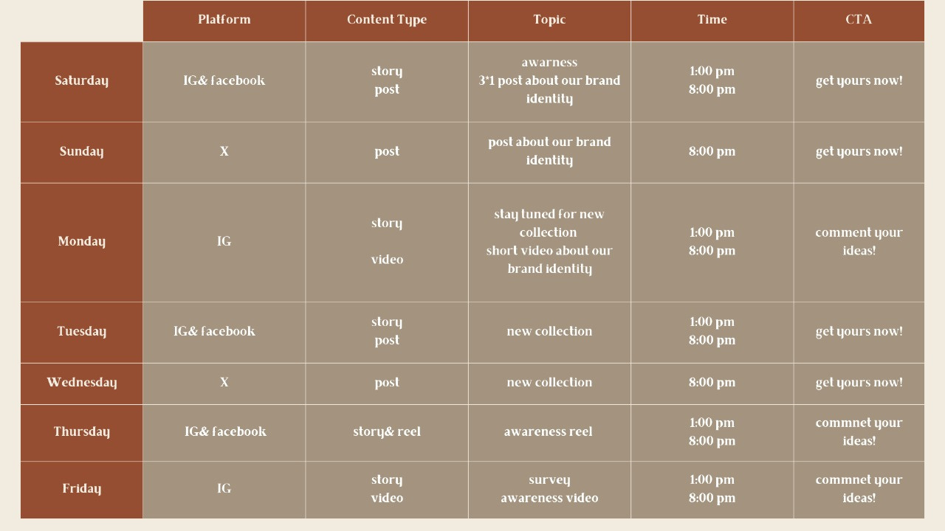
Content calendar

Slide 9
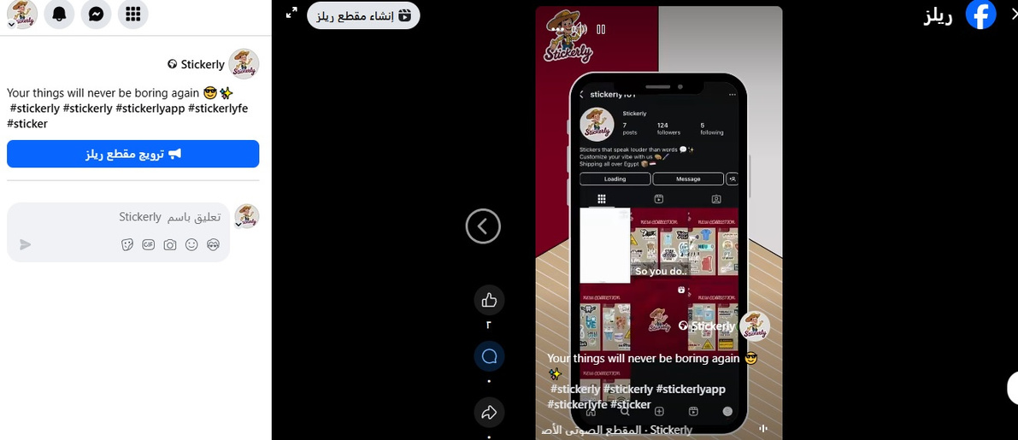
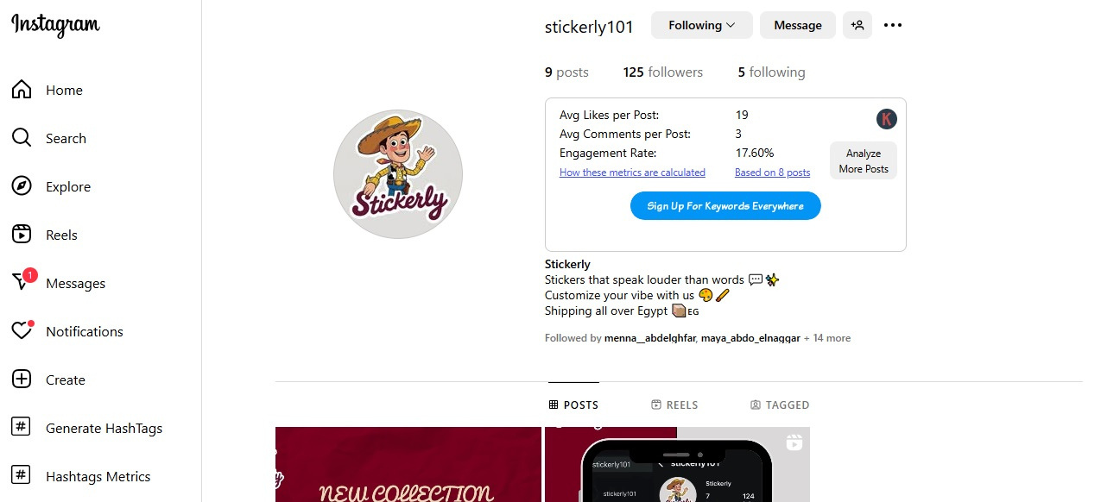
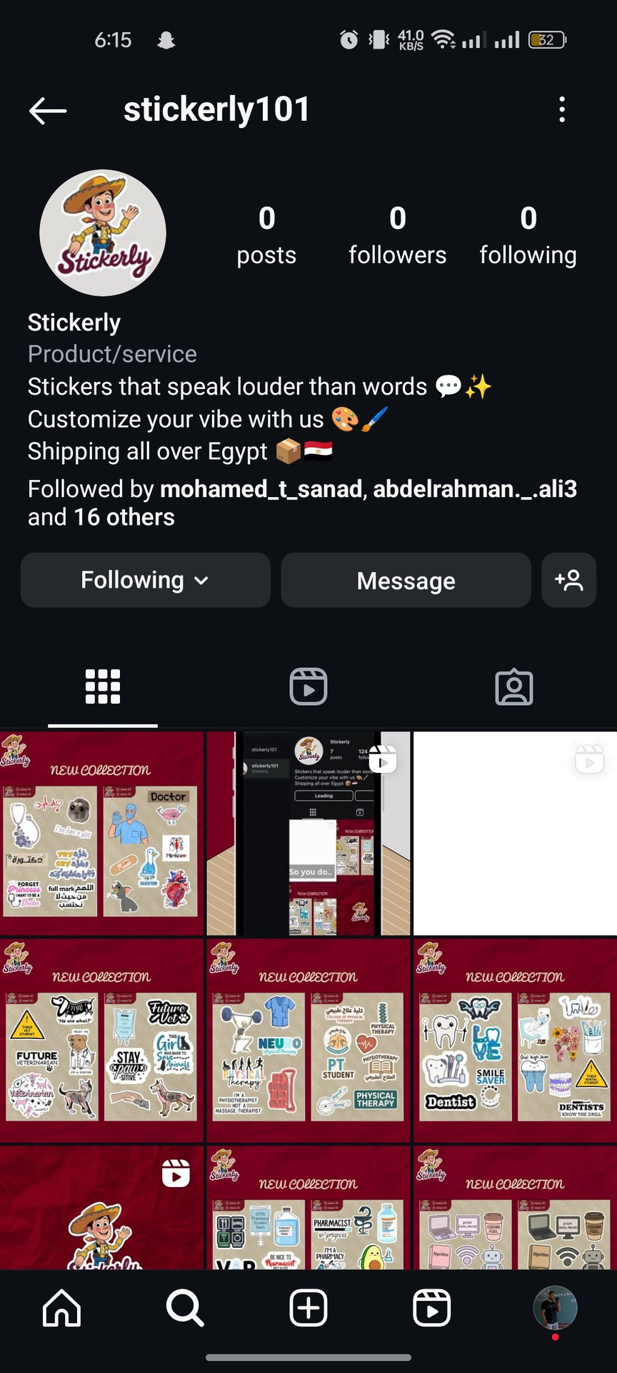
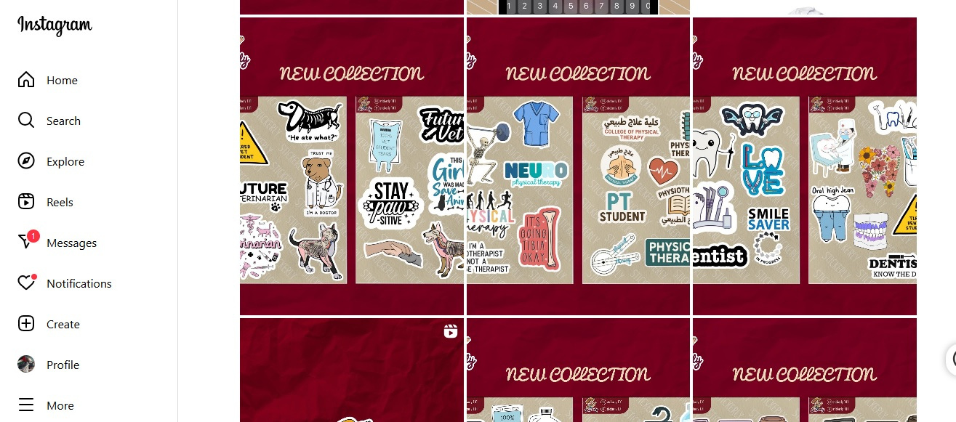
Action Plan

Slide 10
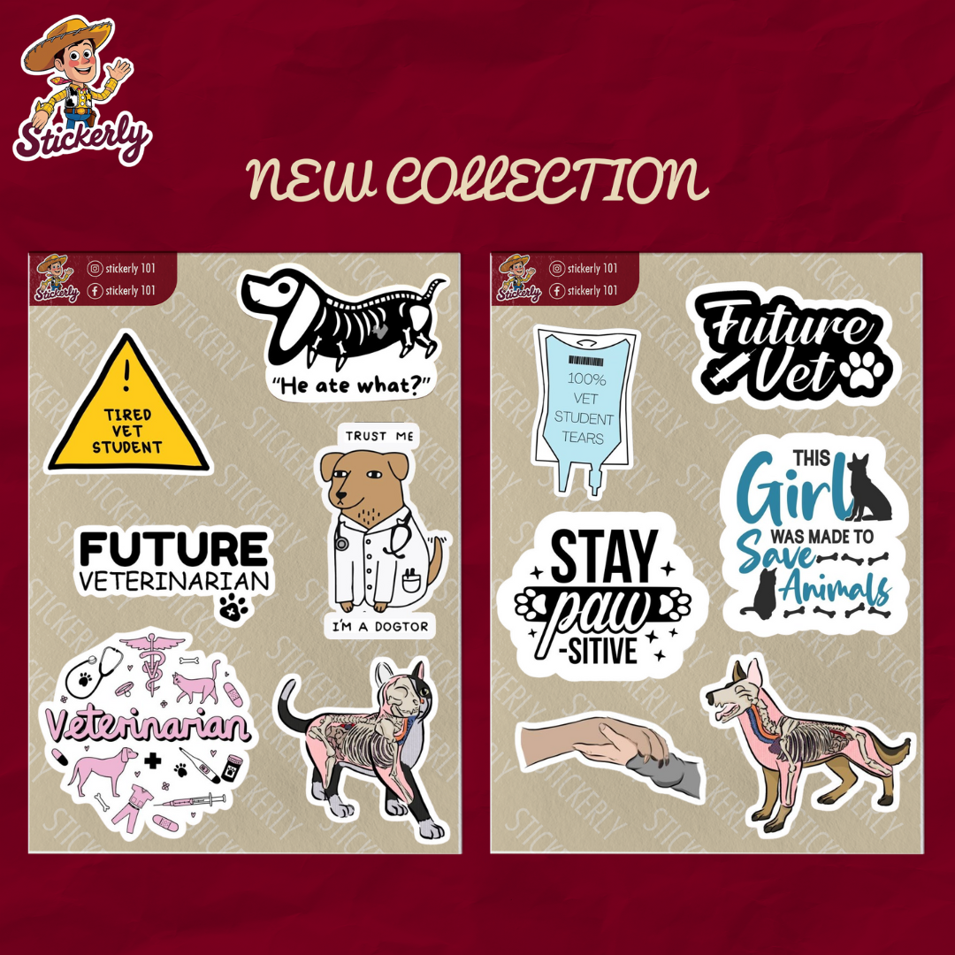
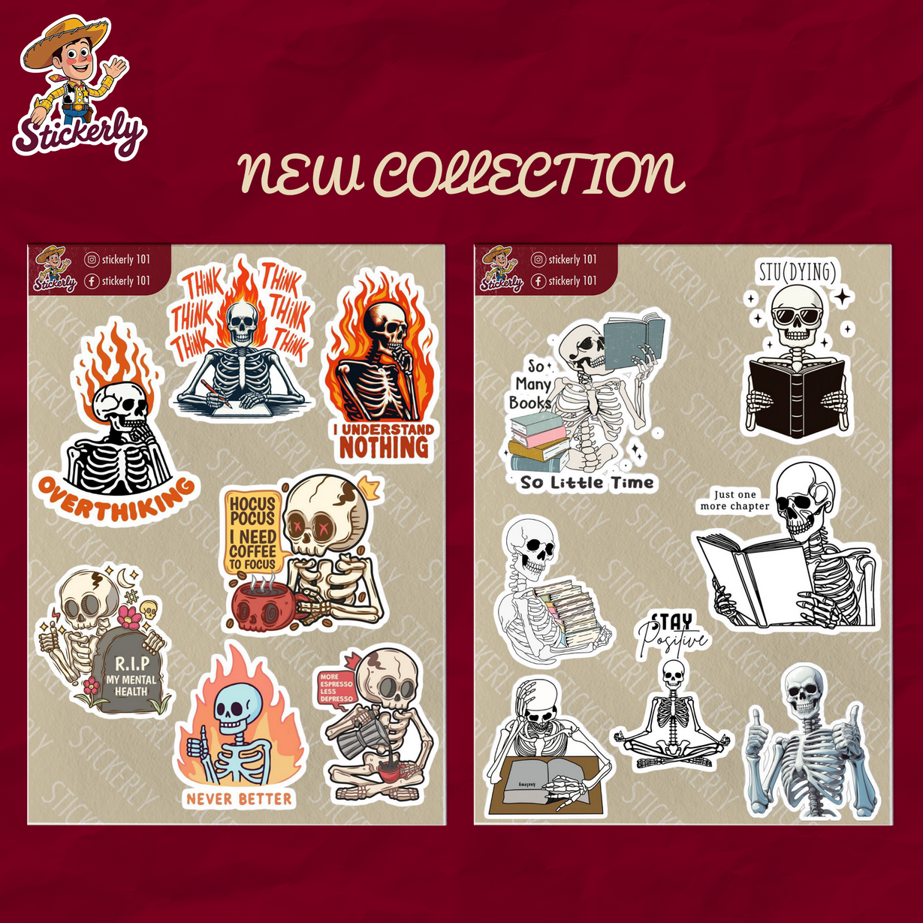
Action Plan

Slide 11
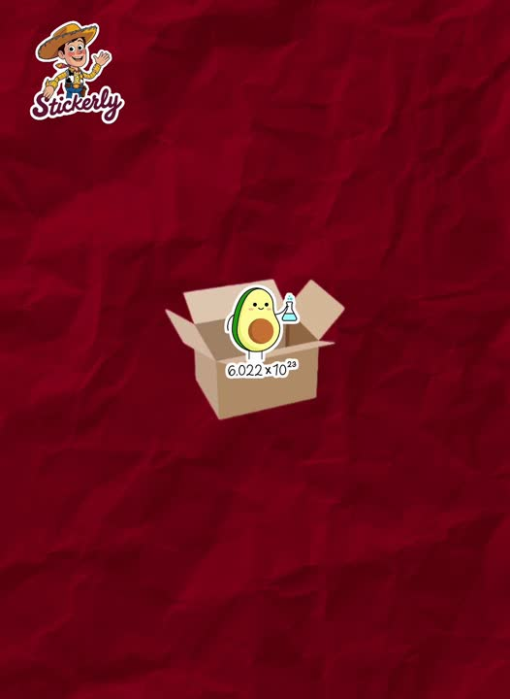
Action Plan

Slide 12
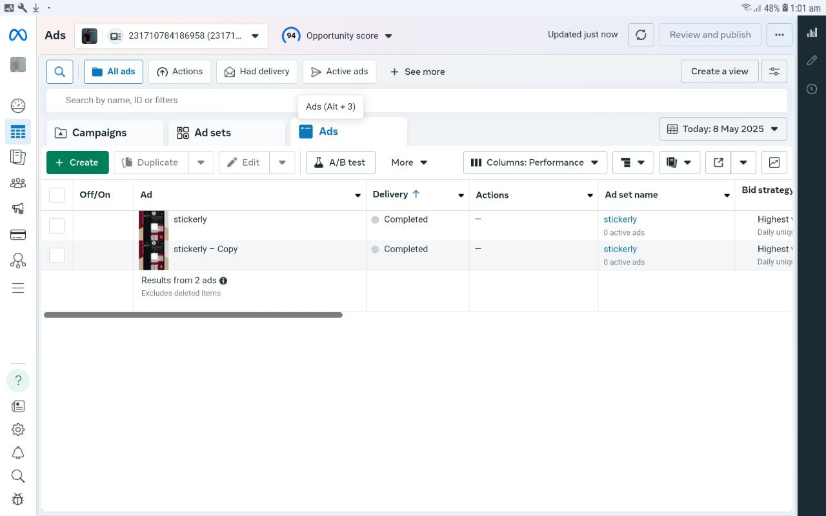
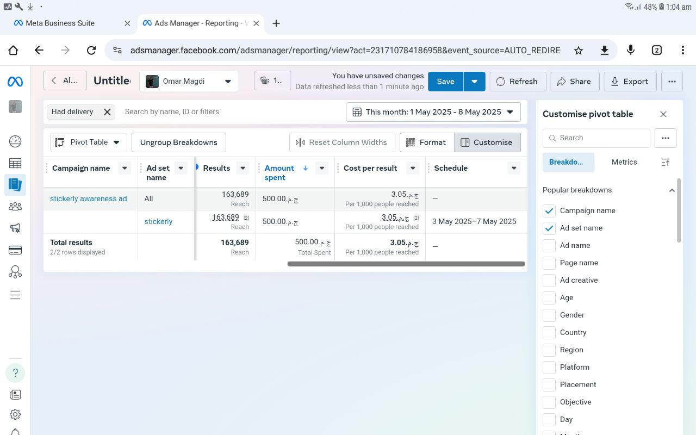
Ad Content published

Slide 13
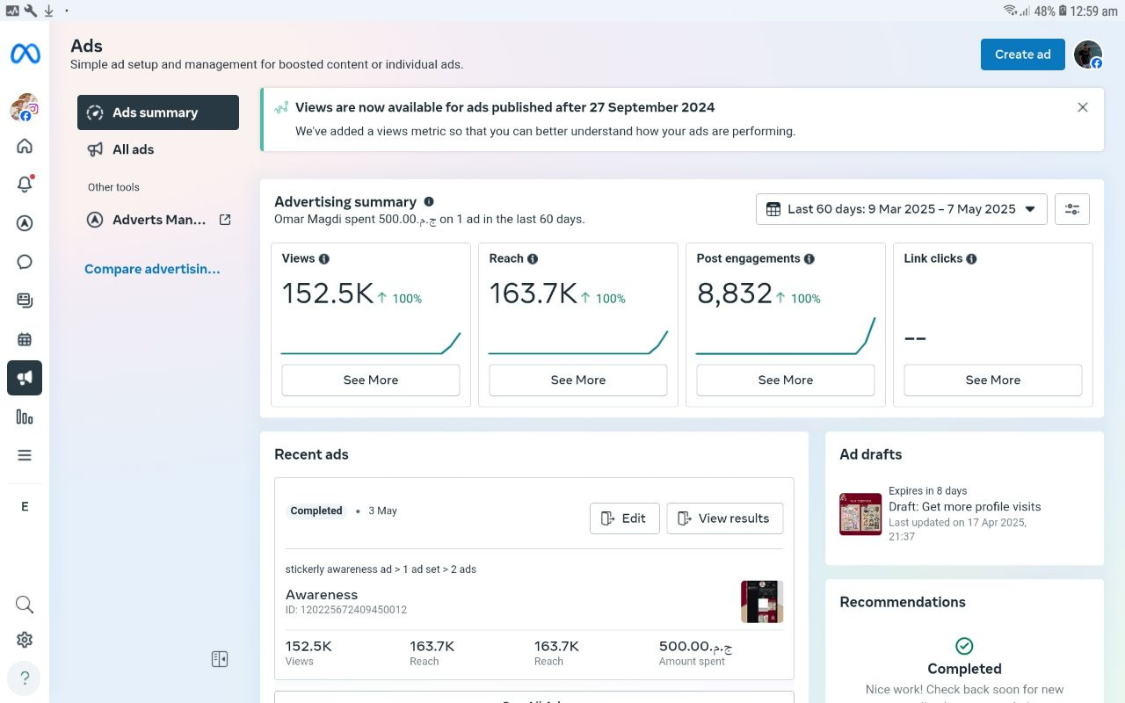
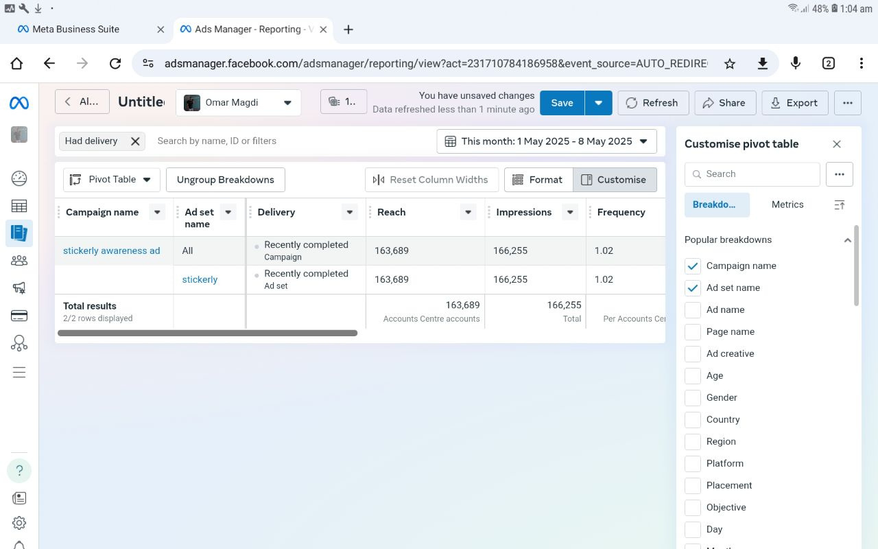
KPIs controls

Slide 14
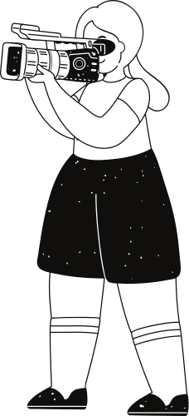
Recommendations
1. Expand customization options.
2. Launch limited edition collections.
3. Offer bundle discounts.
4. Enhance customer reviews & testimonials.
5. Collaborate with student influencers.
6. Participate in university events.
7. Improve delivery process.
8. Introduce a loyalty program.
9. Optimize content strategy.
10. Expand to other platforms

Slide 15
Thank you very much!

